Slide 1

Customer Policy Renewal Prediction & Risk Intelligence
Presented to: Value Momentum
From: Rugwed Yawalkar, Himanshu Sayankar

Slide 2
Where We Are, and Where We Need to Go
1. Our Current Situation:
Policy renewal rates drive recurring revenue for insurance companies.
01
02
Early detection of customers at risk of non-renewal enables pre-emptive retention strategies.
Manual analysis is slow, inconsistent, and misses actionable signals.
03
2. Our Primary Goal:
Predict which customers are likely to renew policies using historical payment, claim, and interaction data.

Slide 3
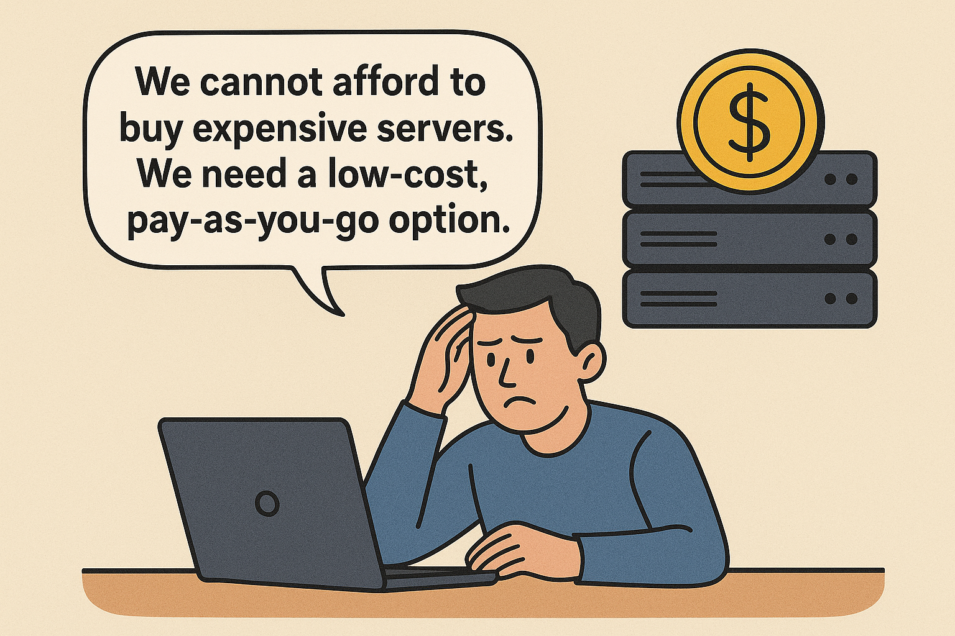


What Do We Actually Need?
We evaluated our business based on the three key considerations:
01
Improve retention with data-driven outreach.
02
Optimize resource allocation for support teams.
03
Boost long-term profitability by reducing churn.

Slide 4
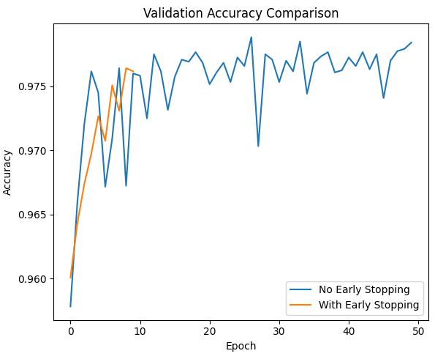
Model Solutions
Algorithms Used:
Logistic Regression (interpretable, baseline)
Tree Ensemble (Random Forest, LightGBM for boosted accuracy)
Balanced Modeling:
Addressed class imbalance using SMOTE, class weights
Compared basic and advanced ML pipelines
Key Metrics:
Accuracy: ~76%
ROC-AUC: ~0.80
Detailed Precision/Recall for ‘Renewed’ vs ‘Not Renewed’

Slide 5
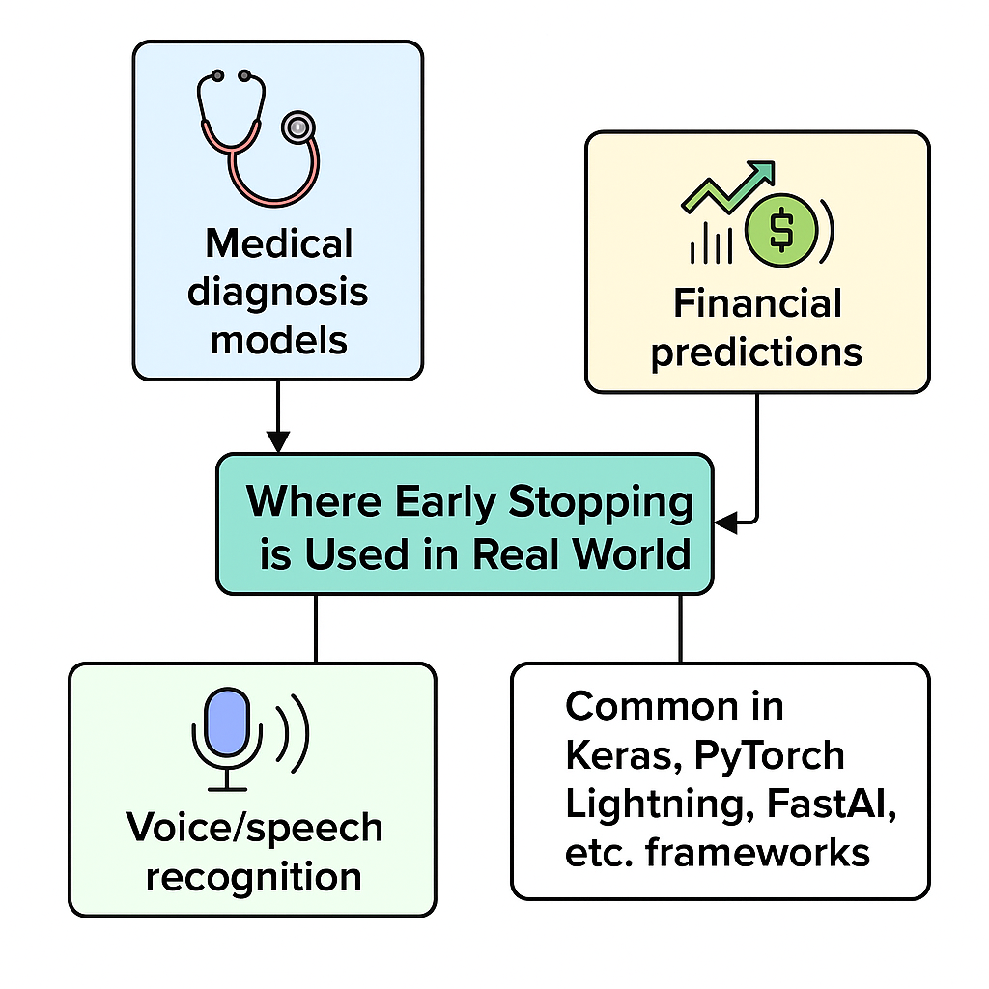
Workflow Overview
WorkFlow:
Data Ingestion → Feature Engineering → Model Training → Evaluation → Dashboard Output
Flow Steps :
Data cleaning & preprocessing.
Feature engineering for actionable signals.
ML training, cross-validation, model selection.
Prediction on new customers frameworks.
Dashboard visualization

Slide 6
Demo: Renewal Prediction Dashboard
Highlights:
Visualize renewal probabilities for each customer.
High-risk segmentation (customizable threshold).
Drill-down: Individual customer profile & top churn/renewal factors.
Feature impact analysis (why each prediction was made).
Key UI Features:
Interactive filtering
Data-driven recommendations

Slide 7
Future Scope
Expand features: customer feedback, granular interaction tracking
Deploy in production with real data
Integrate with CRM and automate retention workflows

Slide 8




Conclusion
Data and AI transform renewal strategy from reactive to proactive.
The dashboard empowers teams with actionable, intuitive insights for smarter policy management!
Enables trust and adoption.
The model delivers clear, trustworthy predictions that help businesses make smarter, revenue-boosting decisions..

Slide 9
Thank You !

